Slide 1
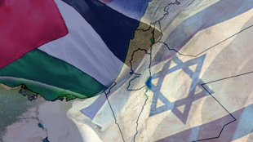
The Vanishing Horizon:
Give Rights A Chance:
The Indispensability of International Law in the Resolution of the Israeli Occupation of Palestine
International Law and the Hope for Peace in the Middle East
Michael Lynk Balfour Project
May 2021

Slide 2

Highly Unequal Struggle
Militarily, Israel is a nuclear power with the strongest armed forces in the region;
Economically, Israel enjoys a European-style standard of living with a GDP per capita 12 times higher than the Palestinian standard;
Territorially, Israel is the overwhelmingly dominant political power between the Mediterranean Sea and the Jordan River;
Diplomatically, Israel has the enduring support of the US and, to a lesser degree, the EU;
Demographically, Israeli Jews and Palestinian Arabs each have roughly 6.8 million people between the Sea and the River.

Slide 3

2020: Obama Reflects
“…[J]ust about every country in the world considered Israel’s continued occupation of the Palestinian territories to be a violation of international law.
As a result, our diplomats found themselves in the awkward position of having to defend Israel for actions that we ourselves opposed. US officials also had to explain why it wasn’t hypocritical for us to press countries like China or Iran on their human rights records while showing little concern for the rights of Palestinians.”
- A Promised Land, p. 627

Slide 4
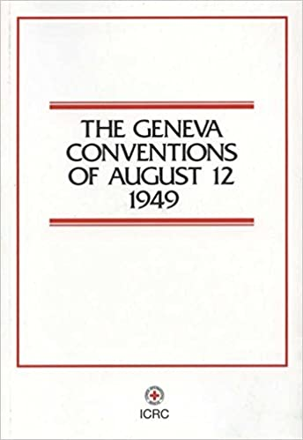
International Humanitarian Law
IHL is the laws of war, codified in the:
1907 Hague Regulations
1949 Four Geneva Conventions
1977 Additional Protocols, as well as in
International Customary Law
Fourth Geneva Convention: Protection of civilians under occupation
International Committee of the Red Cross: Institutional protector and interpreter of IHL
International Court of Justice: In the 2004 Wall Advisory Opinion, the ICJ stated that IHRL and IHL both apply to the OPT, and Israel must honour both.

Slide 5

International Human Rights Law
IHRL is codified in:
1948 Universal Declaration of Human Rights
Two 1966 International Covenants
Nine other international human rights treaties
Israel, as occupying power, is required to respect, protect + fulfill human rights of people under occupation
This includes freedoms of expression, assembly, religion + fundamental guarantees of equality and non-discrimination
Israel prohibited from treating protected population differently from others in comparable position (i.e., Jewish settlers) on grounds of race, religion, political opinion, etc.

Slide 6
Importance of applying principles of IHRL and IHL to the conflict
Israel/Palestine conflict is not only the most malignant and enduring of international conflicts, but also the most international of international conflicts
Rich body of international law and values of equality to guide a just and lasting peace
Strong international consensus on the application of the legal principles to I/P conflict
Principles of international law have been strikingly absent from the ME peace process – Realpolitik has prevailed
Would create a more level playing field between Israel and the Palestinians

Slide 7
International Law has been consistently sidelined throughout the Madrid-Oslo peace process
1993 Declaration of Principles
1995 Oslo II Agreement
2000 Camp David negotiations
2001 Clinton parameters
2003 Quartet principles
2007 Annapolis formula
2013-14 Kerry initiative
2020 Trump Plan

Slide 8
Four Key International Law Issues
Occupation and the Fourth Geneva Convention
Annexation
The Israeli Settlements
Accountability

Slide 9
OCCUPATION

Slide 10
Since 1967, Israel has occupied the West Bank, East Jerusalem and the Gaza Strip
Occupation is governed by the Fourth Geneva Convention of 1949:
1. Occupation must be temporary
2. Occupier acquires absolutely no rights to annex territory
3. Occupying Power must govern in the “best interests” of the population under occupation
4. Occupying Power must govern in “good faith” and follow international law and the directions of the international community
Collective punishment is absolutely prohibited
Palestinians are protected people
(Gaza was formally evacuated in 2005, but Israeli control continues)

Slide 11
Israel’s Arguments:
Fourth Geneva Convention not applicable, therefore territory is “disputed”
Neither Egypt nor Jordan properly held sovereignty over Palestinian territories
Therefore, no prior sovereign = no occupation, and Israel has as good a title as any other country to these lands
UNSC Resolution 242 (1967) is ambiguous and allows Israel to keep some of the territory conquered in 1967: “withdrawal of Israeli armed forces from [X] territories occupied (“des territoires occupies”) in the recent conflict”

Slide 12
International Consensus
Palestinian territories are “occupied”, not “disputed”
UN Security Council has stated on 22 occasions since 1967 that the Fourth Geneva Convention applies in full to the Palestinian territory.
Security Council has “strongly deplored” Israel’s non-compliance and demanded that it “immediately and scrupulously” apply the Convention
International Court of Justice in July 2004: “The Court…finds that [the Fourth Geneva] Convention is applicable to the Palestinian territories…occupied by Israel… [para. 101]

Slide 13
ANNEXATION

Slide 14
Annexation has been strictly prohibited under International Law since the end of WWII (Art. 2 of the Charter of the United Nations).
Principal UN Resolution: UNSC 242 (1967):
“…emphasizing the inadmissibility of the acquisition of territory by war…”
Annexation is now a “crime of aggression” under the 1998 Rome Statute of the International Criminal Court

Slide 15
Israel’s Position:
Entitled to annex East Jerusalem because it is not “occupied” territory
Since 1967, Israel has:
annexed East Jerusalem to West Jerusalem,
created 13 settlements in EJ with 225,000 Israeli settlers, and
constructed a Wall separating East Jerusalem from the Palestinian West Bank
Annexed the Syrian Golan Heights in 1981, with 20,000 Israeli settlers
Trump Peace to Prosperity Plan (January 2020) would have allowed Israel to annex 30-35% of the West Bank

Slide 16
The Response of the United Nations:
UNSC has re-stated the ‘inadmissibility of annexation’ principle in 11 subsequent resolutions regarding the Israeli occupation
1980: UNSC declared Israel’s annexation of East Jerusalem to be “null and void” and a “flagrant violation” of the 4GC (Res. 476 + 478)
UNSC has “strongly deplored” Israel’s contravention of the anti-annexation resolutions, and criticized “the failure of Israel to show any regards for the resolutions of the General Assembly and the Security Council” (Res. 267 + 478)

Slide 17
THE ISRAELI SETTLEMENTS

Slide 18
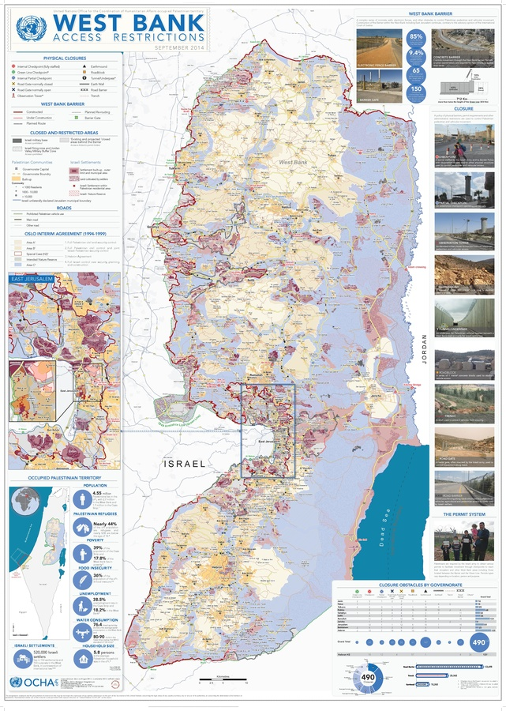
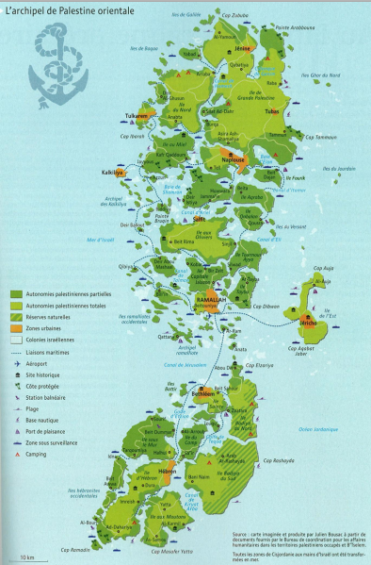
Israeli Settlements
The Palestinian Archipelago

Slide 19
International Law and the Israeli Settlements
Fourth Geneva Convention, Art. 49(6): “The Occupying Power shall not deport or transfer parts of its own civilian population into the territory it occupies”
UN Economic and Social Council (1993): “The range of rights violated by population transfer and the implantation of settlers places this phenomenon in the category of mass violations of human rights.”
UNSC Res. 2334 (December 2016): “…the establishment by Israel of settlements in the Palestinian territory occupied since 1967, including East Jerusalem, has no legal validity and constitutes a flagrant violation under international law…”
Article 8(2)(b)(viii), Rome Statute (1998): War Crime: “The transfer, directly or indirectly, by the Occupying Power of parts of its own civilian population into the territory it occupies…”

Slide 20
Key Facts on the Israeli Settlements
Primary Israeli tool for demographic growth, territorial control + claim for sovereignty in West Bank and East Jerusalem
250 Jewish-only settlements in the OPT
2020 Settler Population:
West Bank: 460,000+ (2000 – 192,000)
East Jerusalem: 225,000 (2000 – 172,000)
Syrian Golan Heights: 20,000 (2000 – 16,000)
Israeli settlements control 42% of West Bank, including areas of planned expansion and the dense network of settler-only roads
12,000+ settlement housing units approved in 2020 by Israel

Slide 21
Human Rights Impact of the Israeli Settlements
UN High Commissioner for Human Rights on the human rights impact of the Israeli settlements:
• Land confiscation of Palestinian property
* Differential rights and laws
• Israeli settler violence
• Discriminatory planning laws
• Appropriation of natural resources
• Demolition of Palestinian homes
• Discriminatory law enforcement
• Shrinking territorial space
* Denial of Self-Determination

Slide 22
ACCOUNTABILITY

Slide 23
Common Article 1 of the Four Geneva Convention of 1949: “The High Contracting Parties undertake to respect and to ensure respect for the present Convention in all circumstances”
International Law on Accountability
Articles 40 & 41 of the 2001 Articles on State Responsibility: States shall cooperate to bring to an end, through lawful means, any serious breach of general international law, and no state shall recognize as lawful a situation caused by a serious breach
Article 25 of the Charter of the United Nations: “the Members of the United Nations agree to accept and carry out the decisions of the Security Council in accordance with the … Charter.”

Slide 24
The Centrality of Accountability: International Law v Realpolitik
Secretary-General Ban Ki-Mon (2016): “…the lack of any significant movement towards a political resolution and ongoing violations of international human rights and humanitarian law [by Israel] were exacerbated by the lack of accountability for previous violations. and that tackling impunity must be the highest priority.”
German Ambassador to the UN (2019): “International law is not an a la carte menu.”
UN Special Rapporteur (2020): “The international supervision of the 53-year-old Israeli occupation of Palestine illustrates that, between international law and accountability, there is an enormous gap between promise and performance. International law should not be an umbrella that folds up when it rains.”

Slide 25
If the Occupation was already Prolonged in 1980…
United Nations Security Council Resolution 476 (30 June 1980)
“Reaffirms the overriding necessity for ending the prolonged occupation of Arab territories occupied by Israeli since 1967, including Jerusalem;”
“Strongly deplores the continued refusal of Israel, the occupying power, to comply with the relevant resolutions of the Security Council and the General Assembly…”

Slide 26
What Lies Ahead?

Slide 27
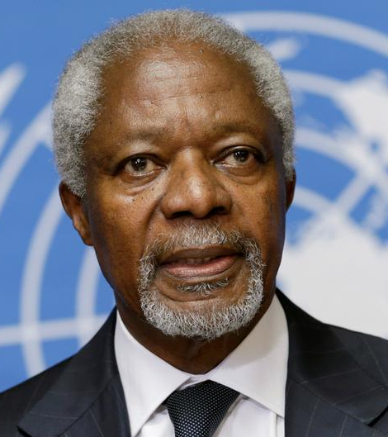
UN Secretary General Kofi Annan in 2006:
“The failure to achieve an Arab-Israeli peace is a core source of frustration and instability in the region…the Israeli-Palestinian conflict is not simply one unresolved problem among many. No other issue carries such a powerful symbolic and emotional charge affecting people far from the zone of conflict.”

Slide 28

Daniel Levy, former Israeli peace process negotiator:
“Human rights and international legality should be our guiding star and no longer be subordinated to maintaining a peace process that has so palpably failed to deliver. That means, for instance, backing Palestinian and Israeli human rights defenders, backing serious investigations into grave human rights violations, including at the International Criminal Court, and prioritizing a permanent ceasefire to protect civilians, in particular in Gaza and southern Israel.”

Slide 29
The Endgame
The five possible solutions/futures for Israel and Palestine
Genuine Two State Solution, based on 1967 borders
One Democratic Bi-National State: Equal Rights for All
One and a Half State Solution: The Trump Plan
One Unequal State: Annexation without Rights
The Status Quo: Managing the Occupation, with de facto annexation continuing

